Slide 1
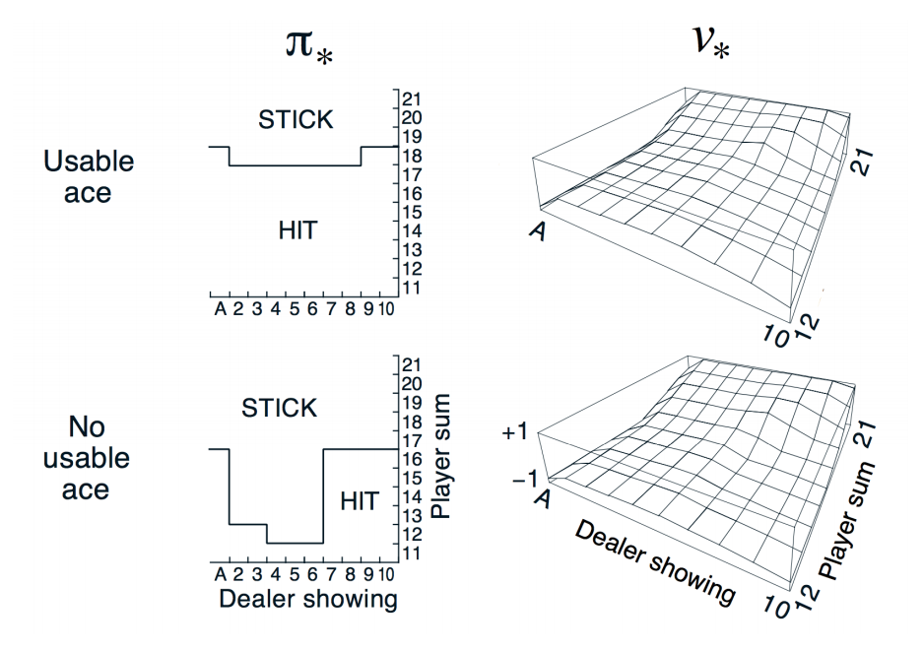

Slide 2
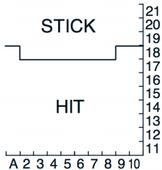

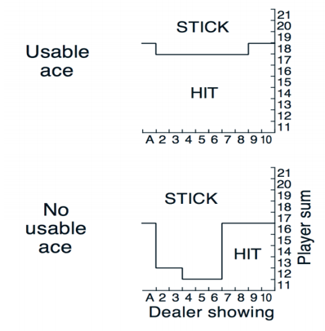

GLIE MC Control (ep =1000000)

Slide 3
for i in range(ep): done, reward, ace, next_player, n_s = 0, 0, 0, 0, 1 state = [0, 0] player_lst = [] e = 1. / ((i // 20000) + 1) player, ace_player = bj.player_card_select() in_dealer, ace_dealer = bj.dealer_card_select() dealer = in_dealer if ace_player == 1: ace = 1 while True: state[0] = player - 12 state[1] = in_dealer - 2 if np.random.rand(1) < e: action = bj.randomaction() # 0 = STICK, 1 = HIT else: action = np.argmax(Q[state[0], state[1], ace]) state, next_player, done, next_ace = bj.step(state, action, ace) # step if player_lst.count([player, in_dealer, ace, action]) != 0: pass else: player_lst.append([player, in_dealer, ace, action]) if done == 1: break else: player = next_player n_s += 1 if next_ace == 2: ace = 1 else: ace = next_ace

Slide 4
while True: dealer_sum, ace_dealer = bj.twist() dealer += dealer_sum dealer, ace_dealer = bj.acenumber(ace_dealer, dealer) if dealer >= 17: break reward = bj.win(next_player, dealer) rAll.append(reward) for j in range(len(player_lst)): p = player_lst[j][0] - 12 d = player_lst[j][1] - 2 if player_lst[j][2] == 2: a = 1 else: a = player_lst[j][2] act = player_lst[j][3] count[p, d, a, act] += 1 Q[p, d, a, act] = Q[p, d, a, act] + (1 / count[p, d, a, act]) * (dis*reward - Q[p, d, a, act])

Slide 5


Sarsa Control (ep =1000000)

Slide 6
for i in range(ep): E = np.zeros([11, 10, 2, 2]) done, reward, ace, next_player = 0, 0, 0, 0 state = [0, 0] e = 1. / ((i // 20000) + 1) player, ace_player = bj.player_card_select() in_dealer, ace_dealer = bj.dealer_card_select() dealer = in_dealer if ace_player == 1: ace = 1 while True: state[0] = player - 12 state[1] = in_dealer - 2 if np.random.rand(1) < e: action = bj.randomaction() # 0 = STICK, 1 = HIT else: action = np.argmax(Q[state[0], state[1], ace, :]) state, next_player, done, next_ace = bj.step(state, action, ace) # step E *= (dis * gma) E[player-12, in_dealer-2, ace, action] += 1 p = player - 12 d = in_dealer - 2 act = action count[p, d, ace, act] += 1 if next_player > 21: nx = 10 else: nx = next_player - 12

Slide 7
if done == 1: while True: dealer_sum, ace_dealer = bj.twist() dealer += dealer_sum dealer, ace_dealer = bj.acenumber(ace_dealer, dealer) if dealer >= 17: break reward = bj.win(next_player, dealer) Q[p, d, ace, act] = Q[p, d, ace, act] + (1 / count[p, d, ace, act]) * (reward - Q[p, d, ace, act]) * E[p, d, ace, act] break else: Q[p, d, ace, act] = Q[p, d, ace, act] + (1 / count[p, d, ace, act]) * (dis*np.max(Q[nx, d, next_ace, :] - Q[p, d, ace, act])) * E[p, d, ace, act] player = next_player if next_ace == 2: ace = 1 else: ace = next_ace

Slide 8
Success Rate
GLIE MC Control
Ep Success rate
10000 0.27
50000 0.33
100000 0.36
200000 0.38
500000 0.41
700000 0.42
1000000 0.43
SARSA
Ep Success rate
10000 0.27
50000 0.35
100000 0.37
200000 0.39
500000 0.41
700000 0.42
1000000 0.43

Slide 9
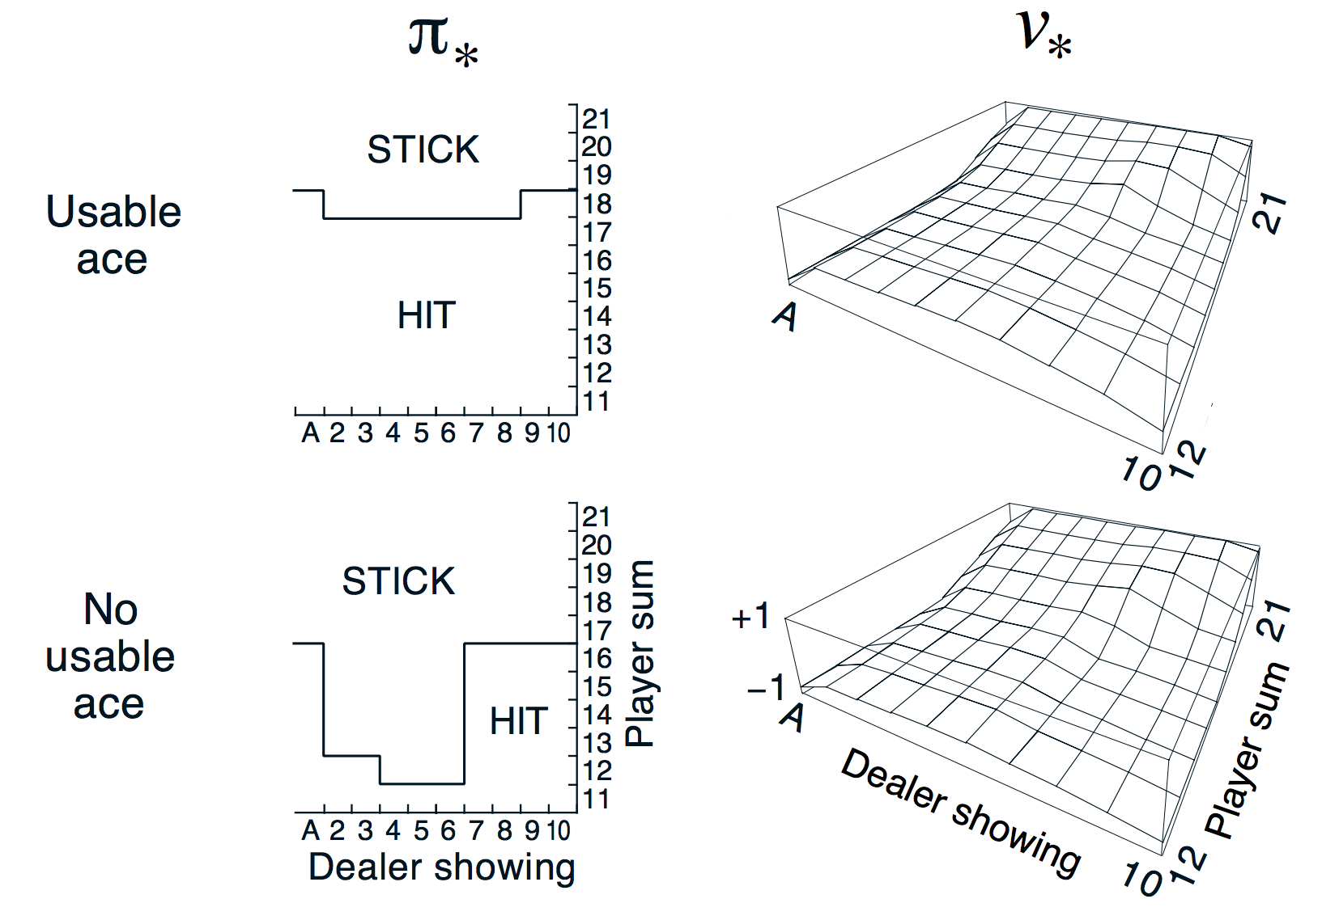
GLIE &
SARSA
(Black jack )
GLIE Monte-Carlo & SARSA Control 을 이용해 학습한 Black-jack

Slide 10
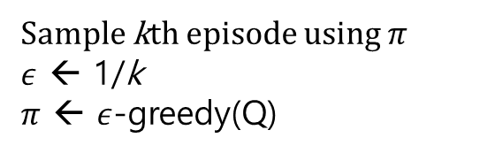

GLIE
* 환경구축
GLIE Monte-Carlo
* Action-value function을 이용하여 향상된 policy를 찾아낸다.
N($S_{t}$, $A_{t}$) ← N($S_{t}$, $A_{t}$) + 1
Q($S_{t}$, $A_{t}$) ← Q($S_{t}$, $A_{t}$) + $\frac{1}{\text{N}\text{(}S_{t}\text{, }A_{t}\text{)}}$($G_{t} −\text{Q}\text{(}S_{t}\text{, }A_{t}\text{)}$)
$G_{t}=R_{t+1}$ + $γR_{t+2}$ + $γ^{2}R_{t+3}$ + … + $γ^{T−1}R_{T}$
Sample kth episode using $π$
$ε$ ← 1/k
$π$ ← $ε$-greedy(Q)

Slide 11
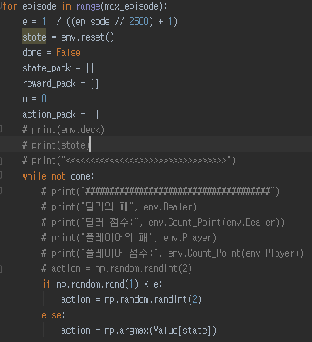
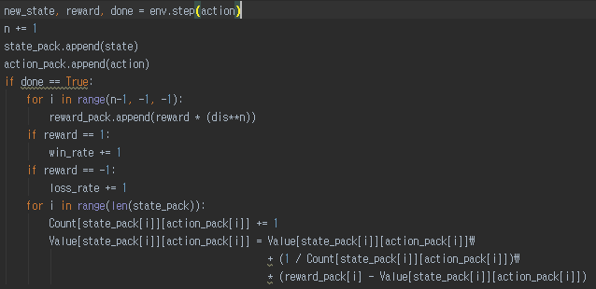






GLIE
* CODE구축
GLIE Monte-Carlo
$ε$ = 1 / (k//2500 + 1)
$ε$ – greedy(Q)
*매 step 마다 state, action 저장
$G_{t}=R_{t+1}$ + $γR_{t+2}$ + $γ^{2}R_{t+3}$ + … + $γ^{T−1}R_{T}$
$γ$ = 0.1
N($S_{t}$, $A_{t}$) ← N($S_{t}$, $A_{t}$) + 1
Q($S_{t}$, $A_{t}$) ← Q($S_{t}$, $A_{t}$) + $\frac{1}{\text{N}\text{(}S_{t}\text{, }A_{t}\text{)}}$($G_{t} −\text{Q}\text{(}S_{t}\text{, }A_{t}\text{)}$)

Slide 12
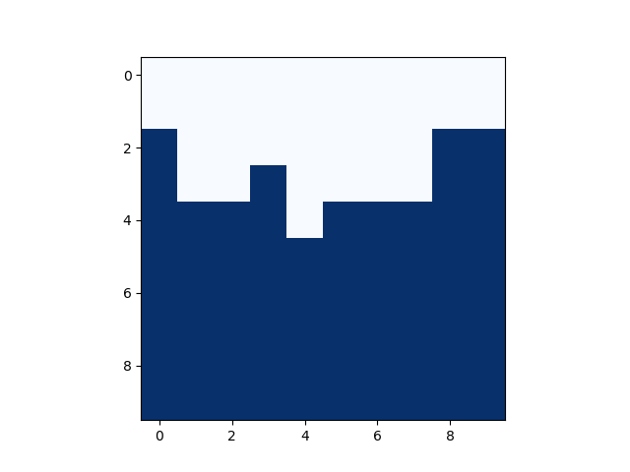
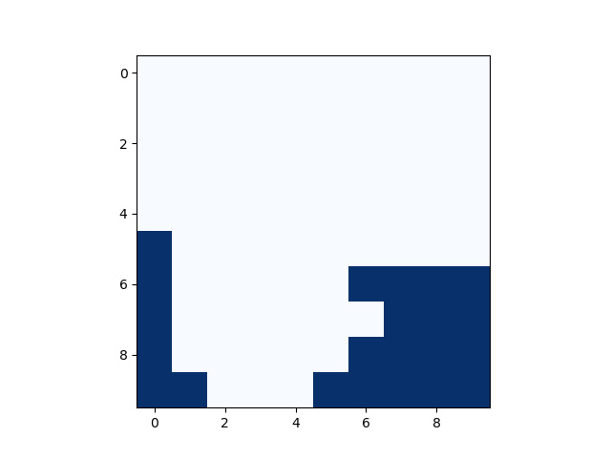
GLIE
* CODE결과
GLIE Monte-Carlo {episode 500000}
Stick
21
20
19
18
17
16
15
14
13
12
Hit
21
20
19
18
17
16
15
14
13
12
Stick
Hit

Slide 13
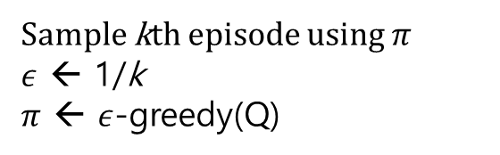
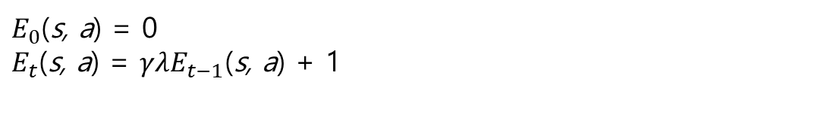
SARSA
* 환경구축
SARSA($λ$)
* Backward View Sarsa($λ$)
Eligibility traces
$E_{0}$(s, a) = 0
$E_{t}$(s, a) = $γλE_{t−1}\text{(}\text{s}\text{, }\text{a}\text{)}$ + 1
TD-error
$δ_{t}=R_{t+1}$ + $γ\text{Q}\text{(}S_{t+1}\text{, }A_{t+1})$- Q($S_{t}$, $A_{t}$)
Q(s$, a$) ← Q(s$, a$) + $α{ δ}_{t}$ $E_{t}$(s, a)
Sample kth episode using $π$
$ε$ ← 1/k
$π$ ← $ε$-greedy(Q)

Slide 14
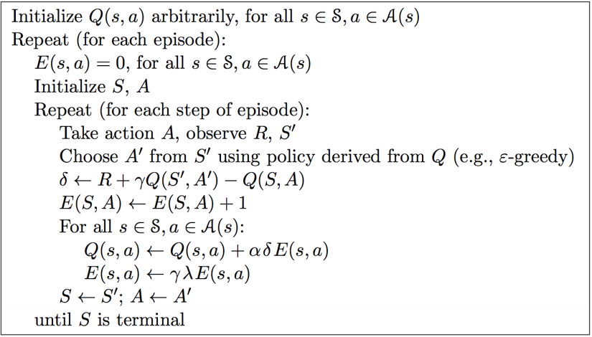
SARSA
* 참고
SARSA($λ$) Algorithm

Slide 15
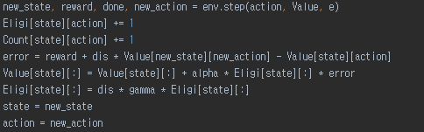
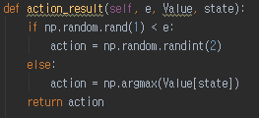







SARSA
* CODE구축
Backward View Sarsa($λ$)
$E_{0}$(S, A) = 0
$E_{t}$(S, A) = $E_{t}\text{(}\text{S}\text{, }\text{A}\text{)}$ + 1
$E_{t}$(s, a) ← $γλE_{t−1}\text{(}\text{s}\text{, }\text{a}\text{)}$
$γ$ = 1.0
$λ$ = 0.1
Q($S, A$) ← Q($S, A$) + $α δ_{t}$ $E_{t}$(S, A)
$α$ = 0.1
$ε$ – greedy(Q)

Slide 16
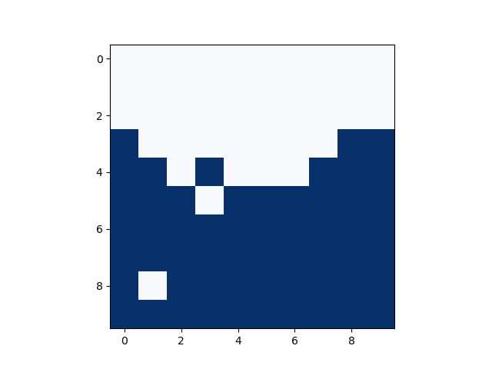
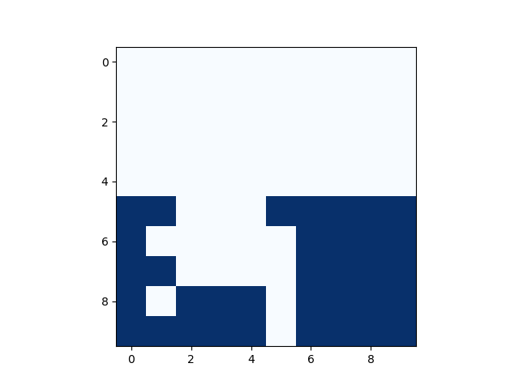
GLIE
* CODE결과
Backward View Sarsa($λ$) {episode 500000}
Stick
21
20
19
18
17
16
15
14
13
12
Hit
21
20
19
18
17
16
15
14
13
12
Stick
Hit

Slide 17
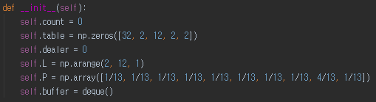
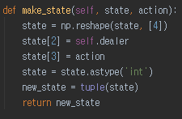
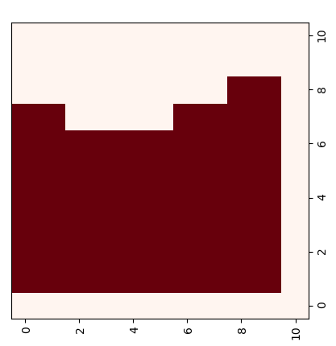
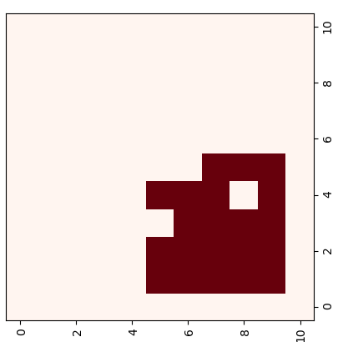

GLIE
Episode 20만
Usable_ace
No_Usable_ace
Evaluate : 정해진 p를 따라 value update하다보면 p의 value값들이 나온다.

Slide 18


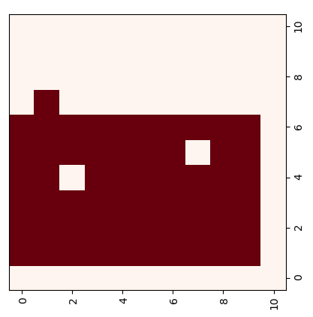
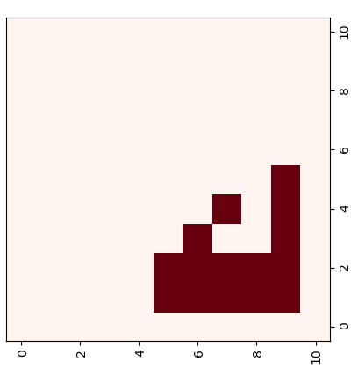
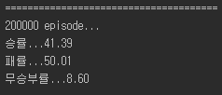
Sarsa
Episode 20만
Usable_ace
No_Usable_ace

Slide 19
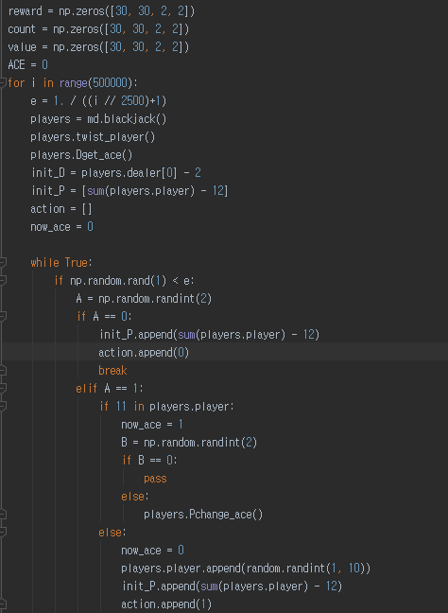
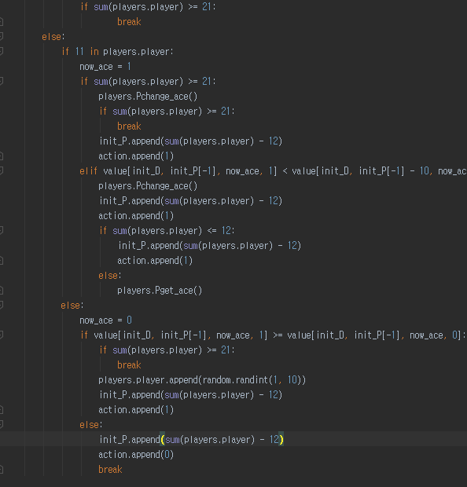
GLIE MC

Slide 20
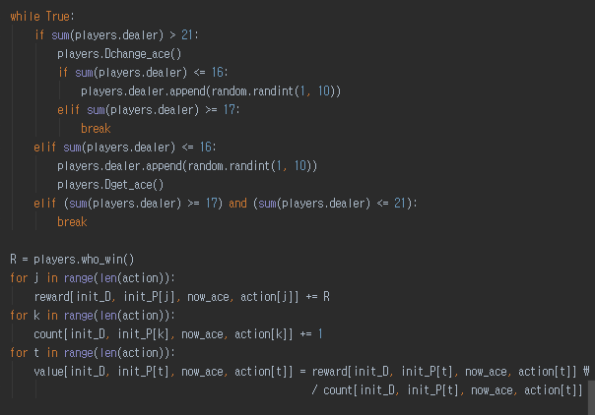
GLIE MC

Slide 21
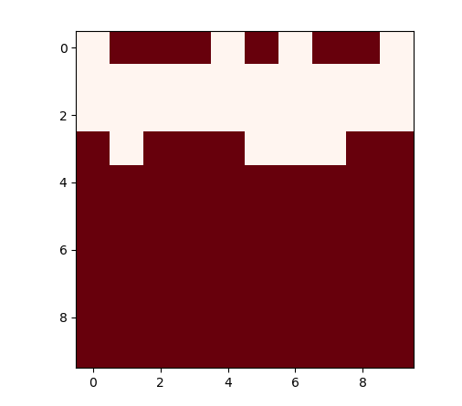
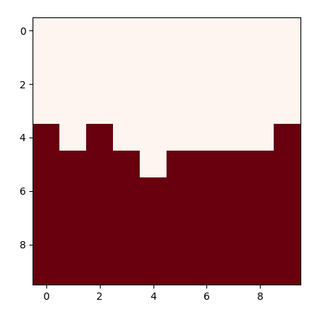
GLIE MC
Useable ace
no ace
500,000
500,000

Slide 22
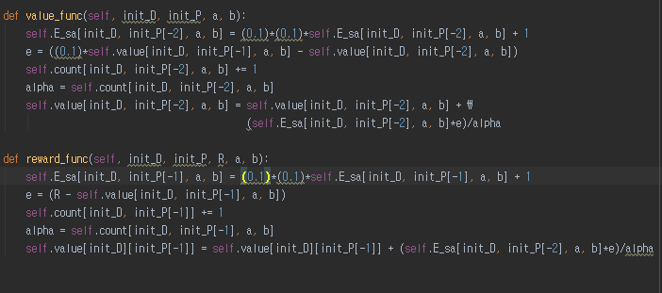
Sarsa(人)

Slide 23
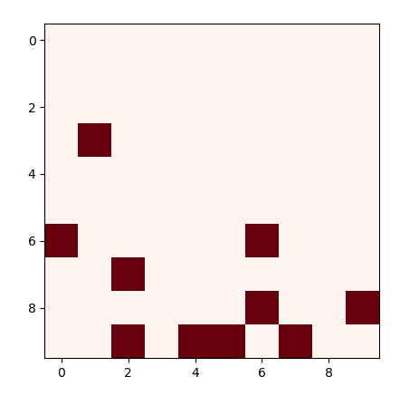
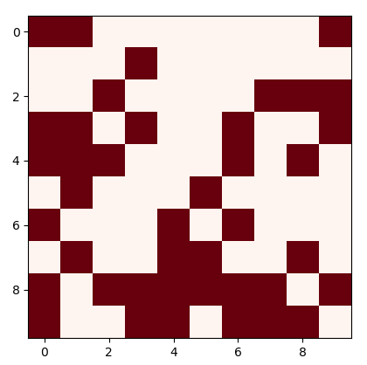
Sarsa(人)
Useable ace
no ace
500,000
500,000

Slide 24
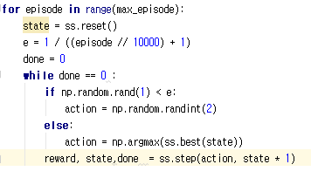
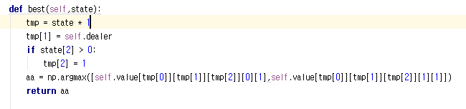
GLIE
죄송합니다 .. 안나옵니다 … 다음에 꼭해놓겠습니다 ….. 죄송합니다 ..

